Slide 1




cidc_chips2 Pipeline
Legend
Cloud Initialization
File
Program(s)
XLSX configuration file
Configuration Parser
Create cloud machine with specified software versions and necessary resources
Input Files
Result Files
Ensembl FTP
Required
Optional
Analysis Configuration yaml
Data Base
Sample Metadata
Pre-processing configuration yaml
FASTA Ref Genome
GTF Gene Annotations / BED file
Pre-processing
Download sample files, Read Pre-processing and QC
Trim adapters, Quality / Length filtering, Read QC, Sample contamination
Read Alignment and Enrichment
Reference genome alignment, Alignment QC, CNV analysis, Peak calling
cutadapt
trimmomatic
FastQC
bwa
bwa
RSeQC
QDNAseq
macs2
samtools
samtools
samtools
Pre-process Benchmarks
Read QC
Sample Contamination
Sorted/ Filtered BAM
BAM Stats
CNV Normalization
Peak calls
Merge With Sample Metadata
Analysis
Read Enrichment / Peak Metrics (FRIPs)
Compare / Combine Replicates
Exploratory Analysis
Genomic Tracks
Differential
Enrichment
Analysis
Peak Annotation / Functional Analysis
Motif Analysis
MEME-ChIP Motif Enrichment Plots
Comparison of Enriched Pathways Plots
Enriched Pathway Dot Plots
Enriched Pathway Tables
Distribution of TF-binding Loci
Genomic Feature Overlap Upset Plots
Genomic Feature Representation Plots
Differential Result Tables
Binding Affinity Box and MA Plots
Significant Regions PCA Plots
Peak Overlap Venn diagram
Genomic Coverage Plots and Tracks
Correlation Heatmaps
PCA Plots
Irreproducibility Discovery Rate Plots
Genomic Interval Enrichment Heatmaps
Cross-Correlation & Peak Profile plots
Read Coverage Uniformity Plots
Reads in Blacklisted Regions Plot
Peak Level Metric Bar/Box Plots
Peak Level Metric Tables
Bam QC Tables & Plots & CNV Plots
Read QC & Contamination Tables
ChIPQC
idr
DiffBind
Gviz
DiffBind
ChIPseeker
MEME
deepTools
ChIPseeker
clusterProfiler
analysis/
chipqc/
analysis/
bigwig/
analysis/
idr/
analysis/
explr/
analysis/ track/
analysis/
diff/
analysis/
annot/
analysis/go/
analysis/
motif/
Reporting
Report.<html|pdf>
Read QC and Peak Metrics
Replicate Analysis
Sample Exploration
Differential Enrichment
Annotations / Functional Analysis
Motif Analysis
PDF/PNG
Figures
KnitR / Rmd
Template
(pdf/html)
CSV
Tables

Slide 2
Workflow Initialization
Parse Configuration file
Sample metadata
Pre-processing options
Analysis and Reporting options
Cloud Initialization Automation:
Launch cloud instance with adequate resources and specified software versions
Mount needed storage drives
Download reference data

Slide 3
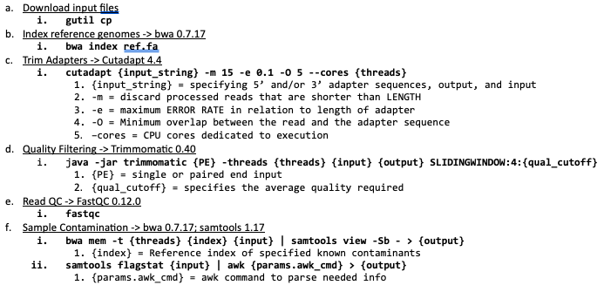
Pre-processing Phase 1

Slide 4
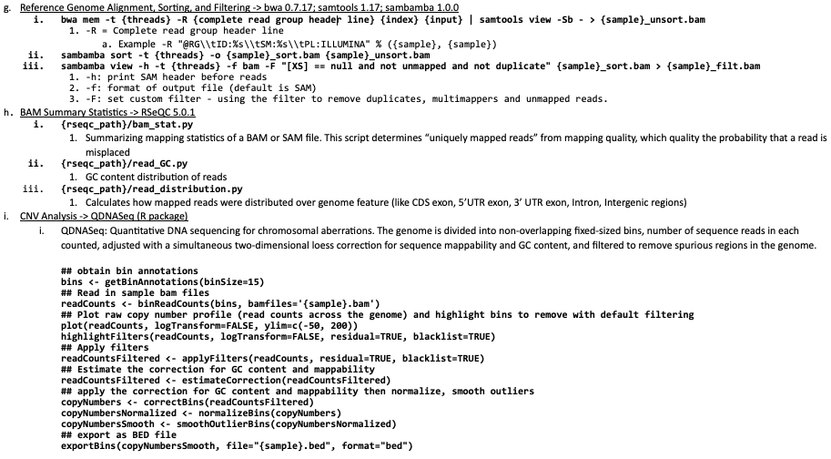
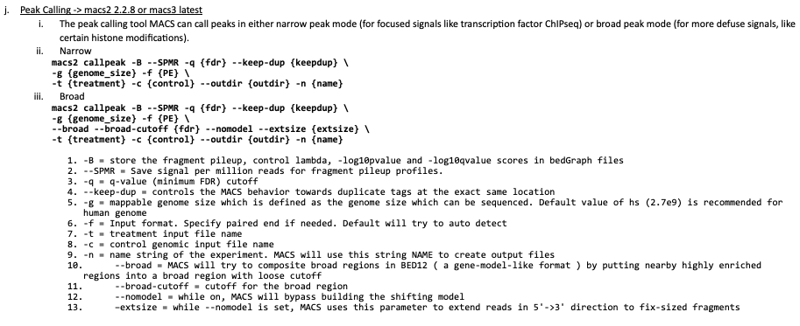
Pre-processing Phase 2

Slide 5
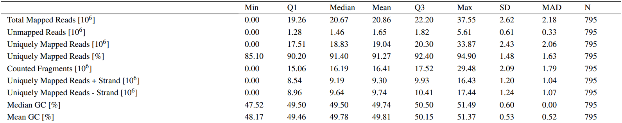
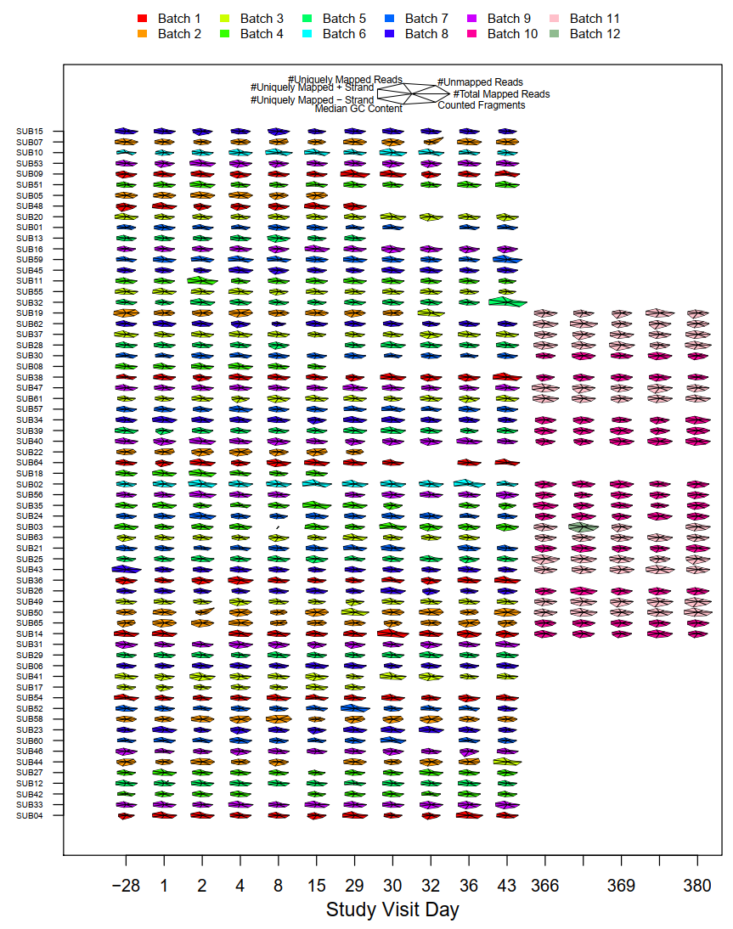
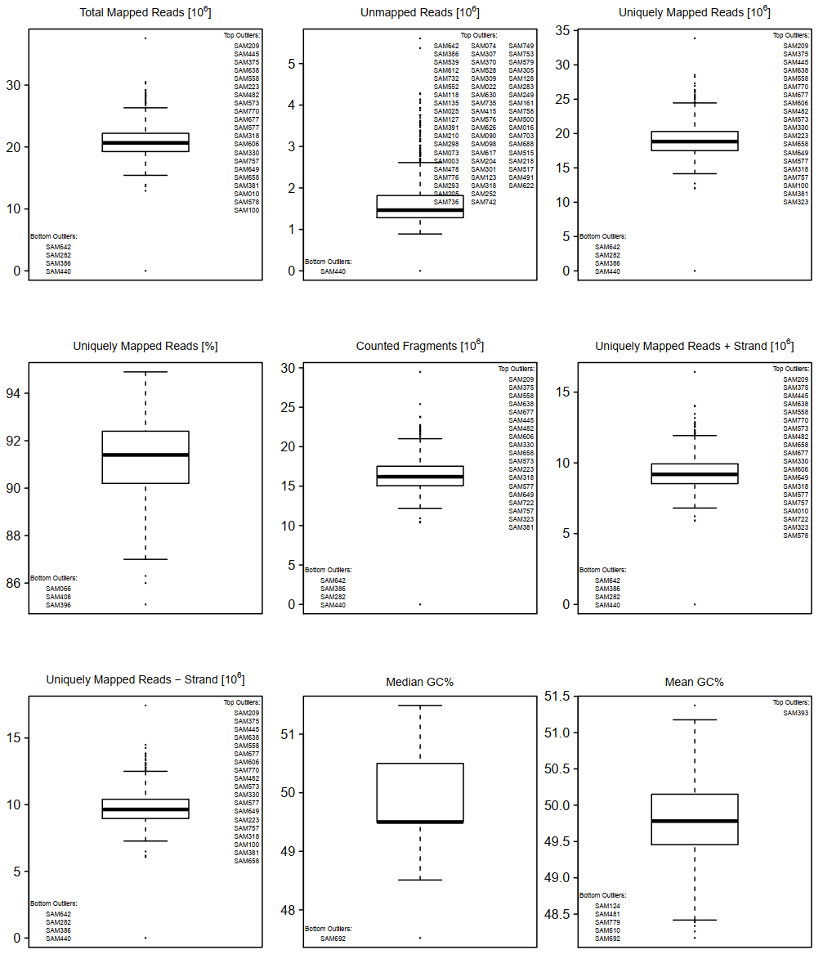
Analysis / Reporting
Alignment Stats -> RSeQC 5.0.1

Slide 6
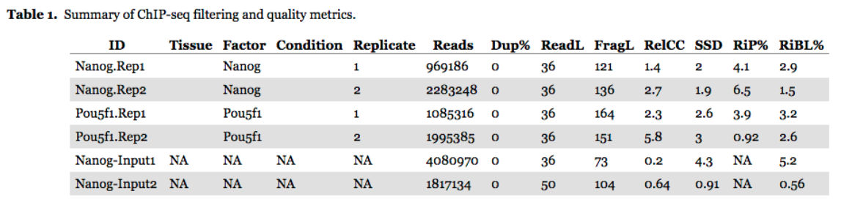
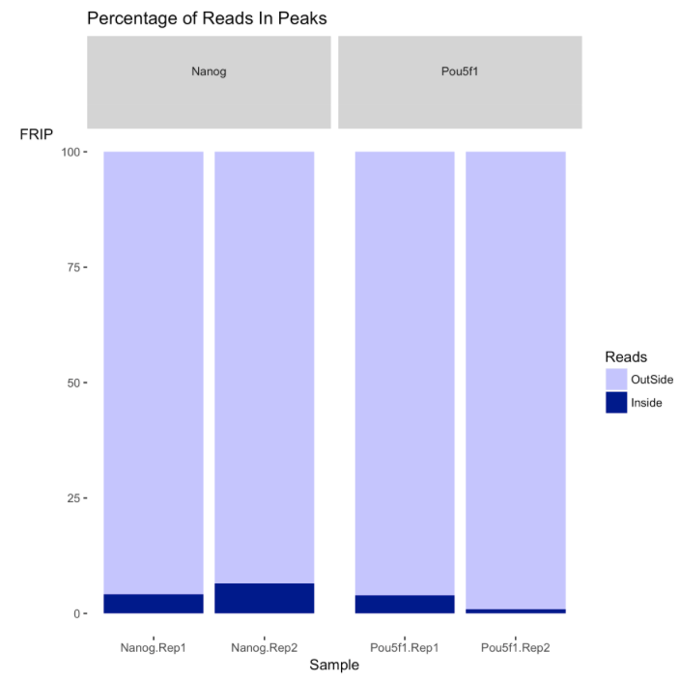
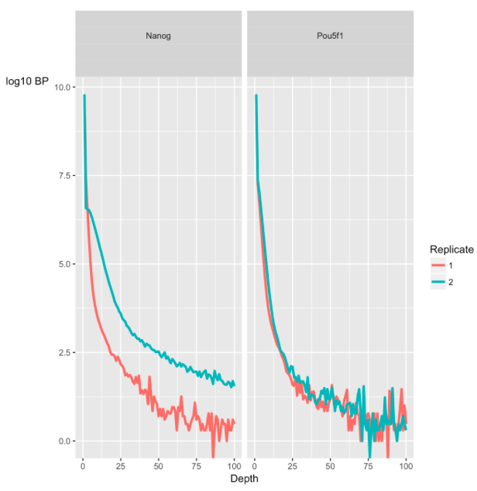
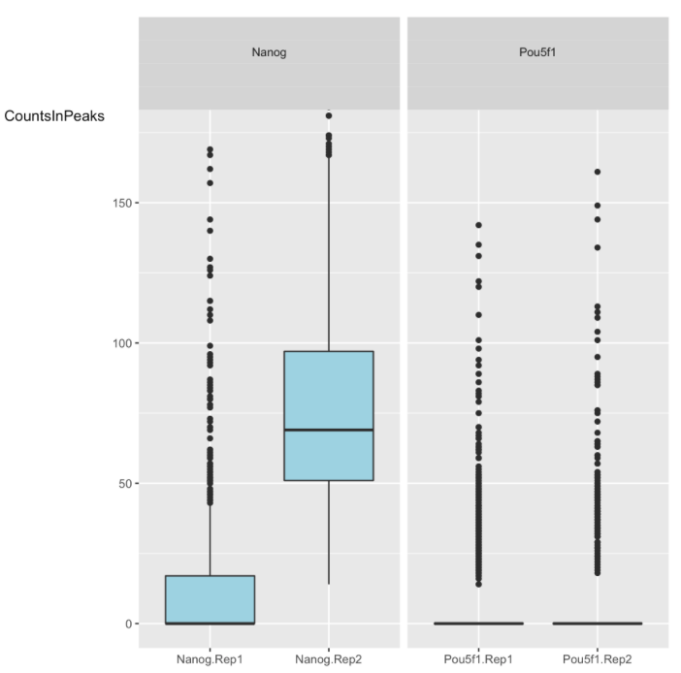
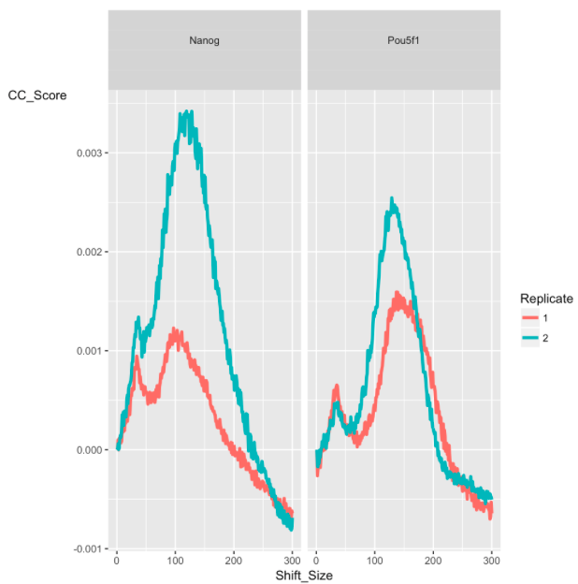
Analysis / Reporting
Peak QC Metrics -> ChiPQC (R package)

Slide 7
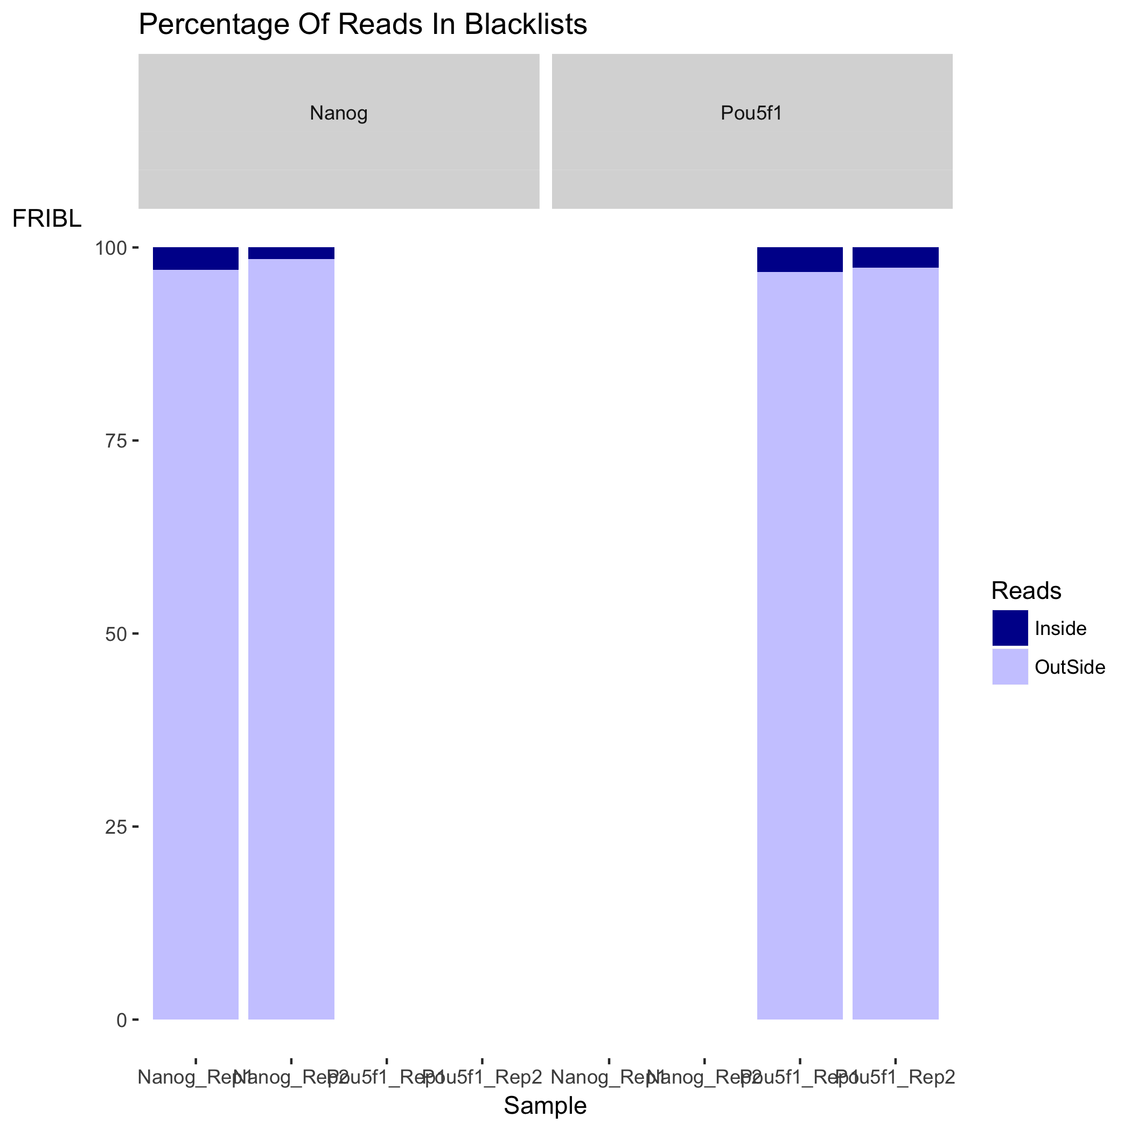
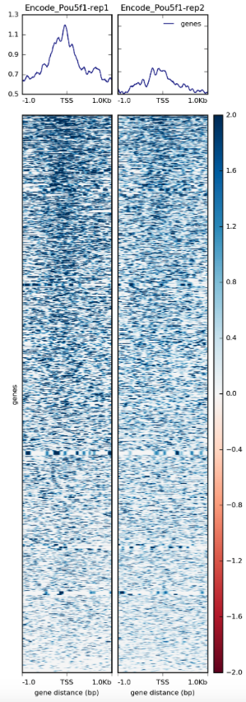
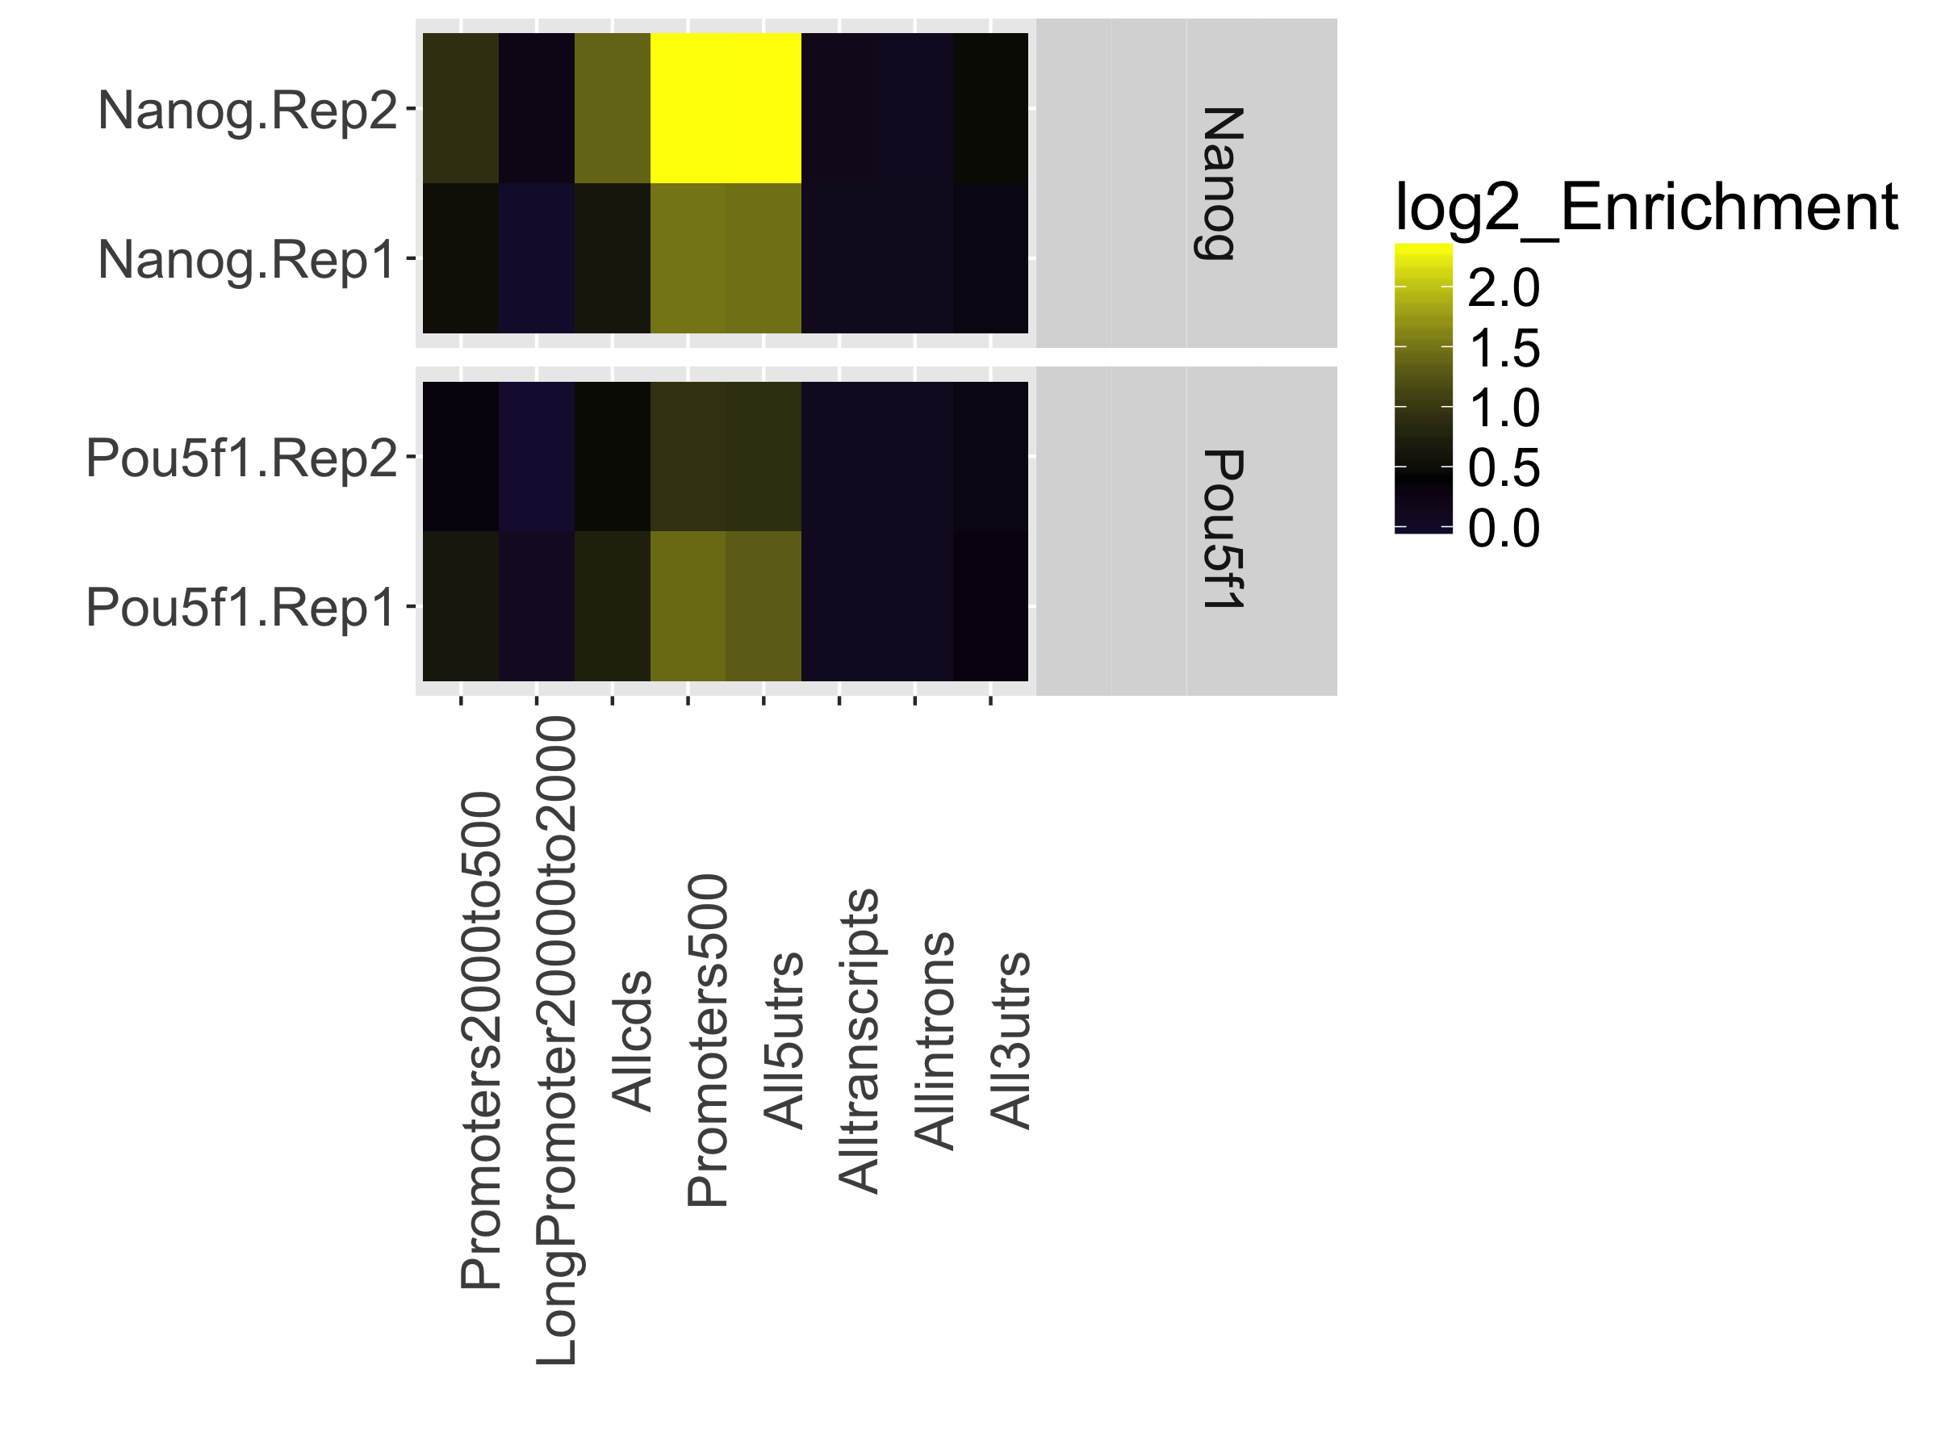
Analysis / Reporting
Peak QC Metrics -> ChiPQC (R package); deepTools 3.5.2

Slide 8
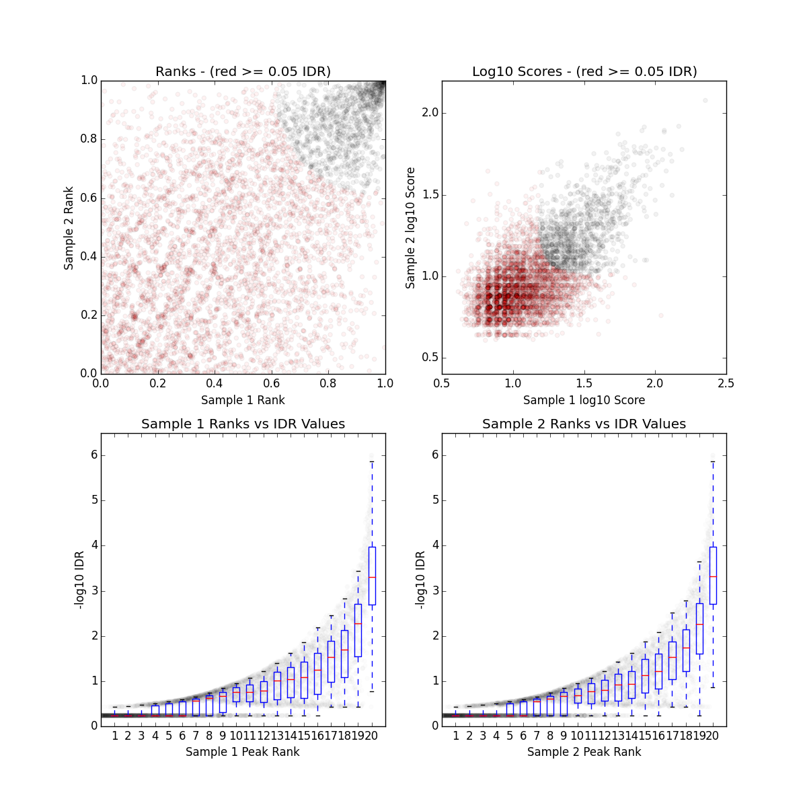
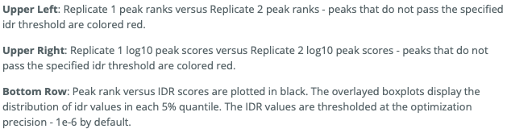
Analysis / Reporting
Compare / Combine Sample Replicates -> idr 2.0.3
(optional)

Slide 9
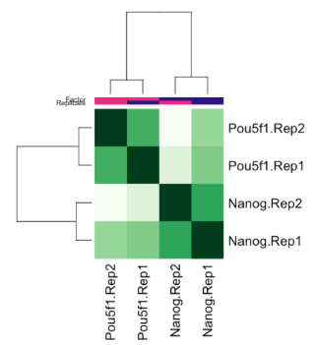
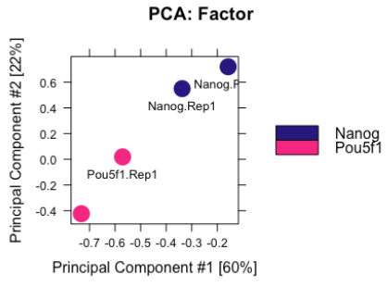
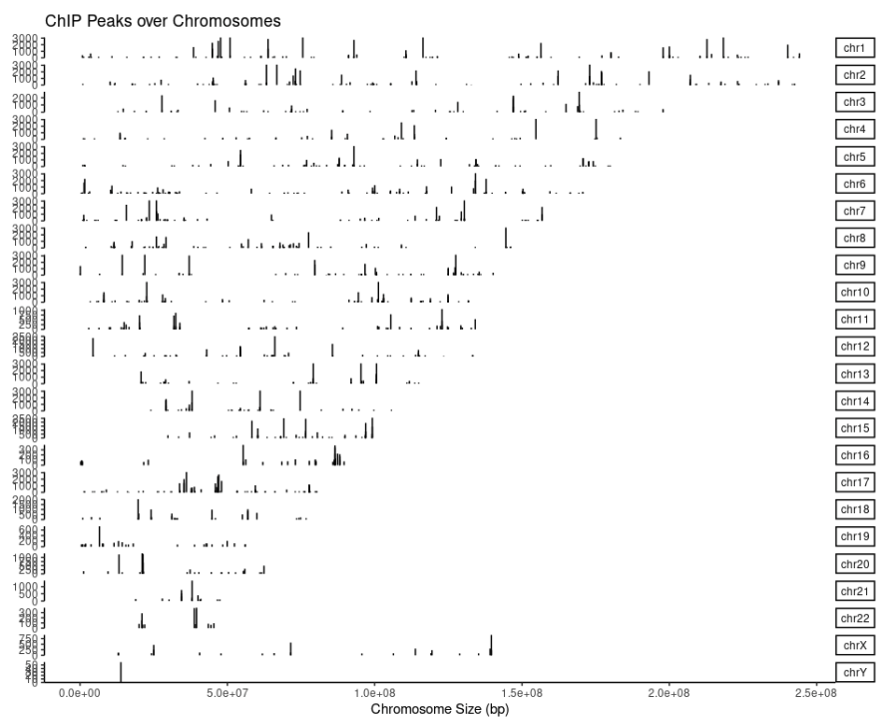
Analysis / Reporting
Exploratory Analysis -> Diffbind (R package); ChIPseeker (R package)

Slide 10
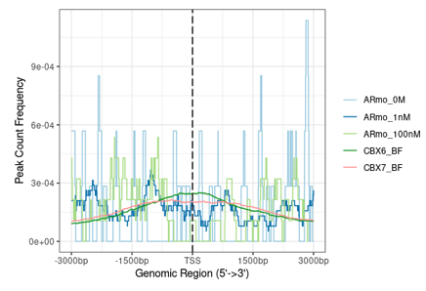
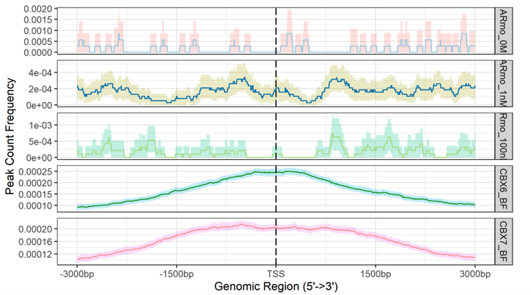
Analysis / Reporting
Exploratory Analysis (Cont) -> ChIPseeker (R package)
Profile Plots

Slide 11
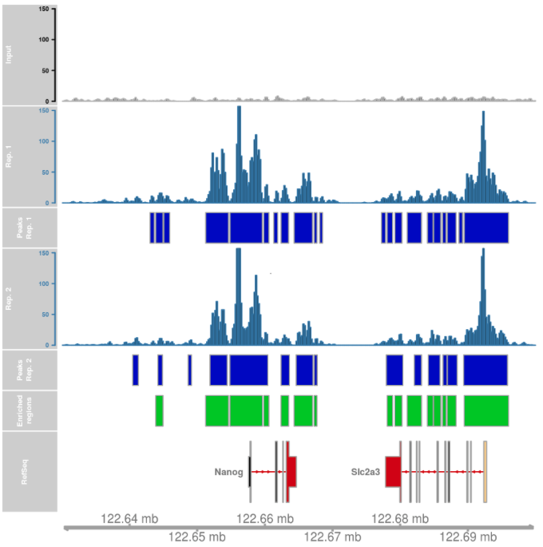
Analysis / Reporting
Exploratory Analysis (Cont) -> Gvis (R package)
Genome Tracks

Slide 12
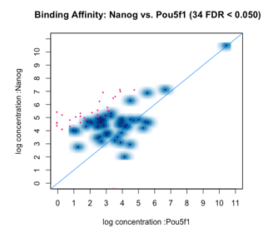
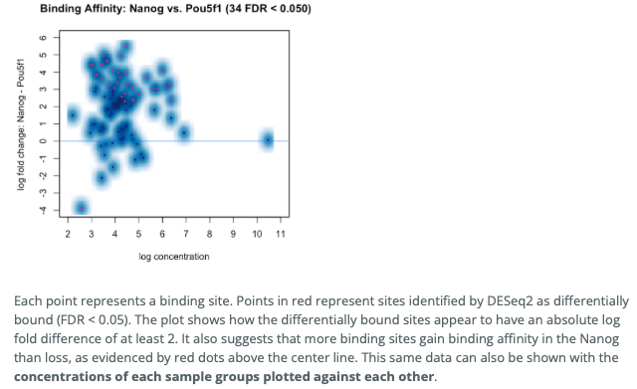
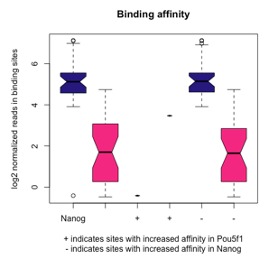
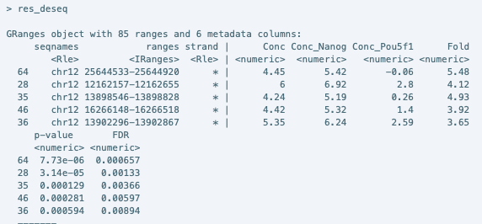
Analysis / Reporting
Differential Enrichment Analysis -> DiffBind (R package)

Slide 13
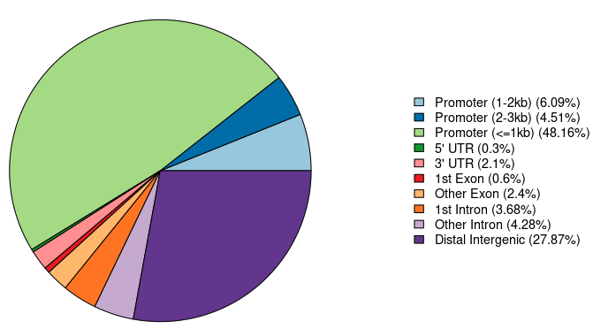
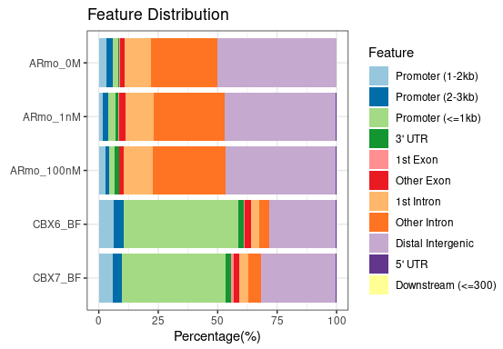
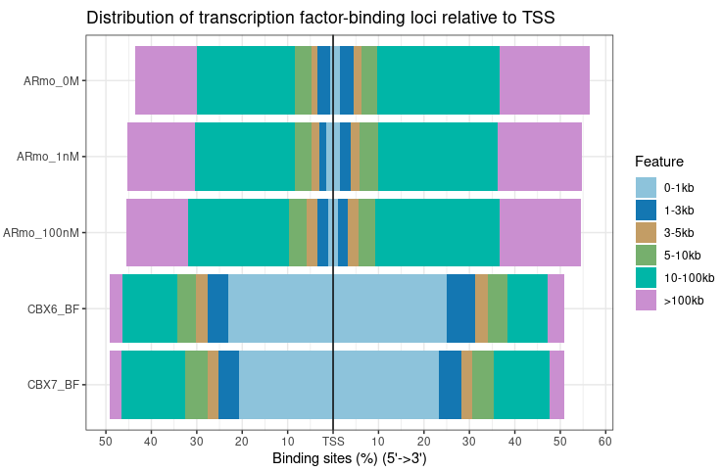
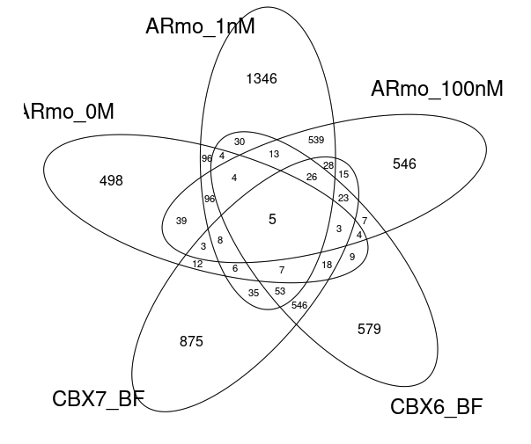
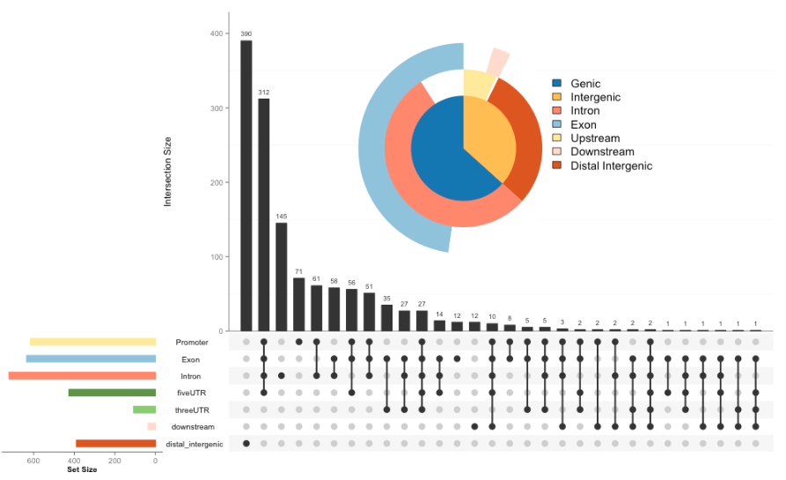
Analysis / Reporting
Annotation and Functional Analysis -> ChIPseeker (R package)

Slide 14
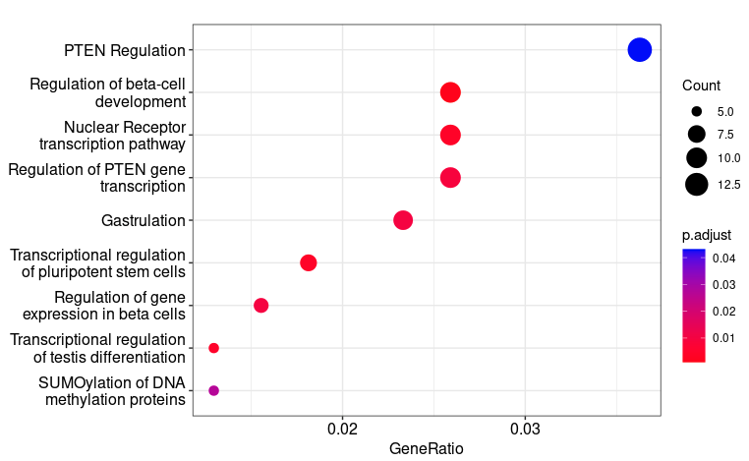
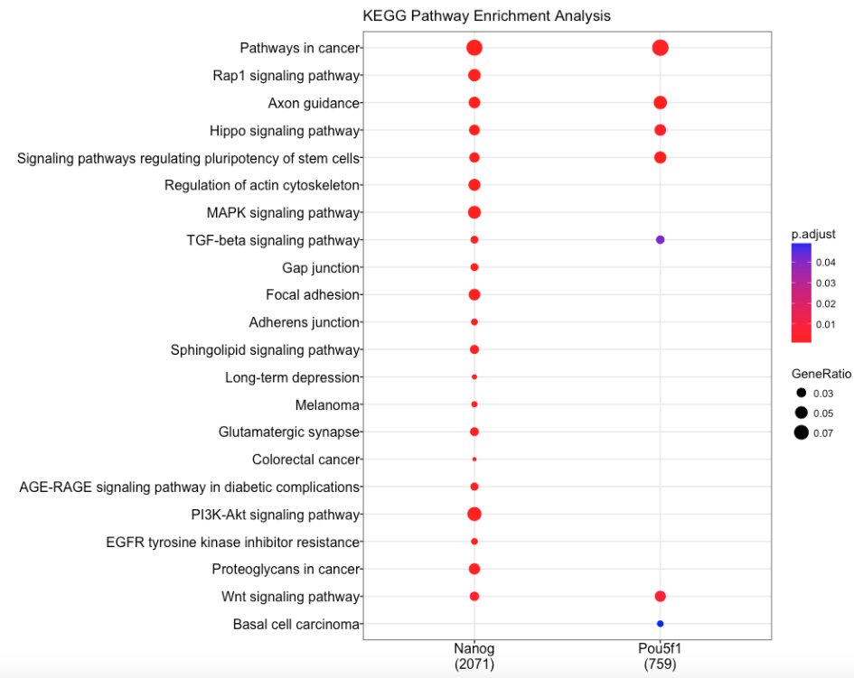
Analysis / Reporting
Functional Analysis (Cont) -> clusterProfiler (R package)

Slide 15
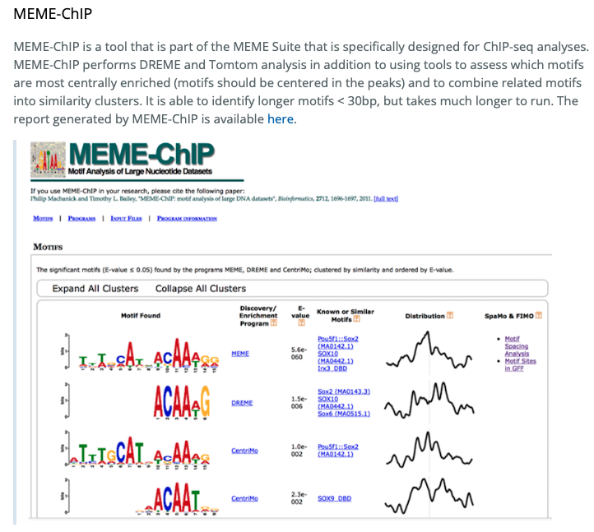
Analysis / Reporting
Motif Analysis -> MEME suite

